Slide 1

Pillars of OOP
Let’s gooo…
Abstraction
Encapsulation
Polymorphism
Inheritance
Class
Object

Slide 2
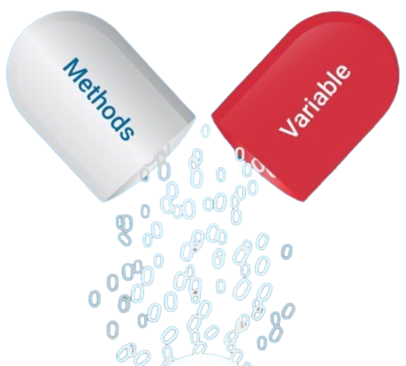

1
Encapsulation
Binding Data & Functions

Slide 3
Introduction
Encapsulation is the binding data and functions that work on those data to generate a single unit called object. A class is a program-code-template that allows developers to create both data and functions. Data and functions are what we call attributes and methods. Class is an example of encapsulation.

Slide 4
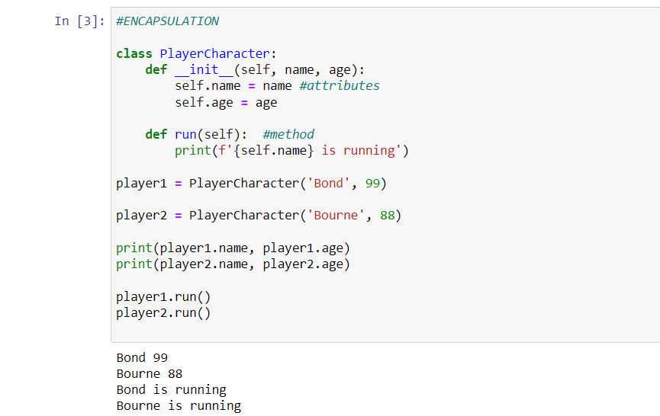
Let’s look at the example below:

Slide 5
Explanation
In the example, we can see that attributes and methods are bound inside a blueprint called class. The class is invoked while creating an object. Now, each object will have their own attributes and methods to work on those attributes. i.e. attributes and methods are encapsulated within object.

Slide 6
Advantages of Encapsulation
1
2
Models real world
Reduce Errors
3
4
Easy to Understand
Easy to Maintain

Slide 7
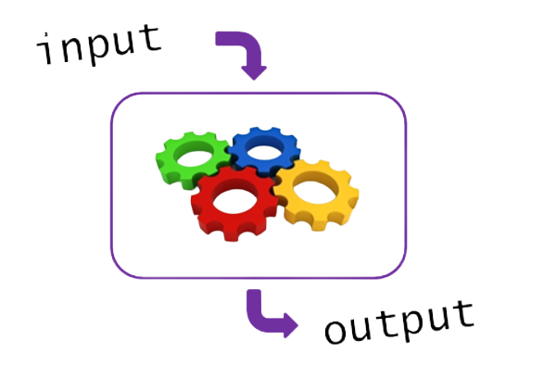
2
Abstraction
Handling Complexity

Slide 8
Introduction
Abstraction means hiding of information or abstracting away information and giving access to only what is necessary. i.e. the working mechanism is hidden but the features are available to users. It is important because it hides backend complexity and allows user to work from top of the abstraction.

Slide 9
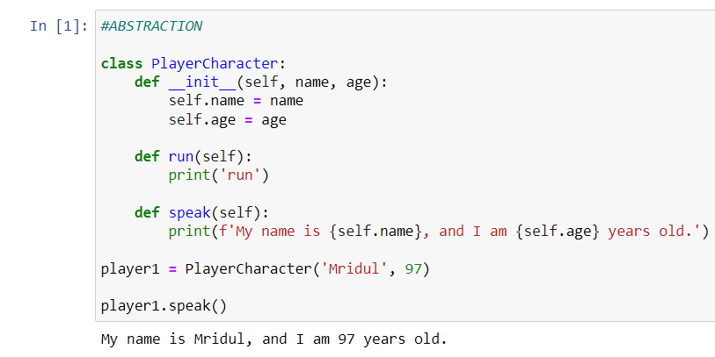
Let’s look at the example below:

Slide 10
Explanation
In the example, we can see that “player1.speak()” gives us an output where name and age of a person is displayed but we as a user do not need to understand how it is happening.

Slide 11
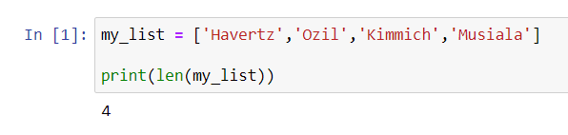
Let’s look at another example:

Slide 12
Explanation
In the last example, we use something called “len(my_list)”. It gave us the length of our list but we do not necessarily need to know on how ‘len’ does what it does. We only need to implement it and do not require any specialization on working mechanism of len.

Slide 13
Advantages of Abstraction
1
2
Handling Complexity
Increased Efficiency
3
4
Maintainable
Modular

Slide 14
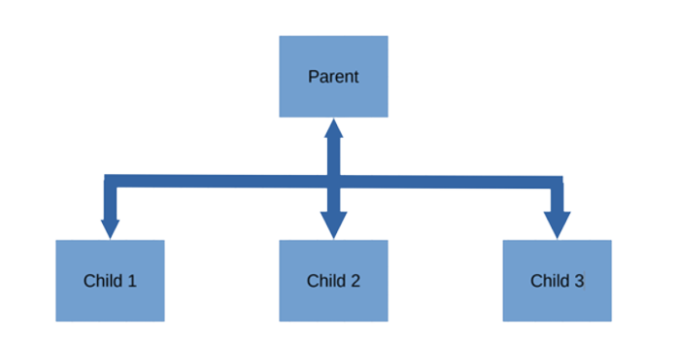
3
Inheritance
Obtaining properties & characteristics

Slide 15
Introduction
Inheritance allows us to define classes that inherits all the methods and properties from another class. The class from where the properties are being inherited are called parent class or base class while the class that inherits from another class is known as child class or derived class.

Slide 16
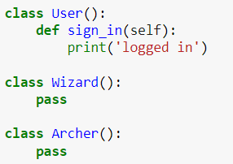
Let’s look at the example below:

Slide 17
Explanation
Initially, only the “User” class have access to the “sign_in” function. But how can the function be accessed by other classes ??
Well, Inheritance is the solution.

Slide 18
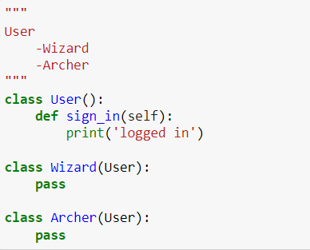
Let’s look at the example again:

Slide 19
Explanation
As we needed access to sign_in, we passed the name of parent class as argument to the child class.

Slide 20
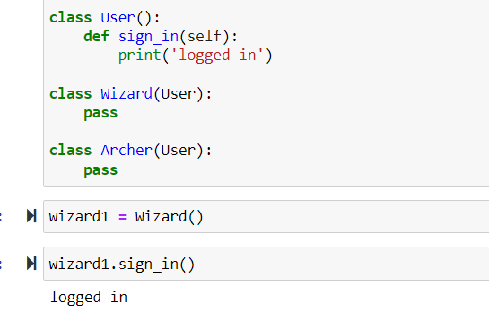
Let’s look at the example again:

Slide 21
Explanation
Although, the wizard class do not have sign_in method, we can now access the method using inheritance.

Slide 22
Advantages of Inheritance
1
2
Reusability
Increased
Efficiency
3
4
Maintainable
Extensible

Slide 23

4
Polymorphism
Multiple forms

Slide 24
Introduction
In OOP, methods are bound to objects. Polymorphism allows us to use same method name for different objects and the methods will give a different response based on which object called it.

Slide 25
Advantages of Polymorphism
1
2
Reusability
Increase Efficiency
3
4
Maintainable
Easy Debugging

